Slide 1




DELTA AIRLINES (DAL)
FINANCIAL ANALYSIS - GROUP 9
PRABHLEEN KAUR
RAJWINDER KAUR
AJAY HHAJI KORBE
NAVJOT KAUR

Slide 2

TABLE OF CONTENTS
INTRODUCTION
HISTORY
GROWTH AND PERFORMANCE
INDUSTRIAL COMPETITORS
MARKET SHARE
RATIO ANALYSIS
CAPM AND WACC
SMA AND EMA
STOCK PRICE TREND
MONTE CARLO SIMULATION
FB PROPHET ANALYSIS
RECOMMENDATIONS
CONCLUSIONS
REFERENCES
FB PROPHET

Slide 3

INTRODUCTION
Establishment:
Founded: 1924 as Huff Daland Dusters in Macon, Georgia.
Headquarters: Atlanta, Georgia
Mission : To provide the highest quality air travel and services, ensuring safety, efficiency, and customer satisfaction
Services:
Passenger Airlines: Serving over 300 destinations in 50+ countries
SkyTeam Alliance: Global airline network.
SkyMiles Loyalty Program: Miles-based rewards for frequent flyers.
Cargo Services: Global freight transport.
Delta Sky Club: Exclusive airport lounges for premium customers.

Slide 4
HISTORY
1924: Founded as Huff Daland Dusters, the first commercial crop-dusting company.
1941: Moved headquarters to Atlanta, Georgia.
1987: Acquired Western Airlines, increasing West Coast presence.
2005–2007: Filed for bankruptcy, emerged stronger with restructuring
1928: Renamed Delta Air Service; began passenger flights in 1929.
1953: Merged with Chicago and Southern Air Lines, expanding international routes.
1991: Acquired assets of Pan Am, including transatlantic routes and New York hub.

Slide 5
HISTORY
2008: Merged with Northwest Airlines, creating the world’s largest airline at the time.
2010: Focused on brand transformation, loyalty programs, and profitability.
2024–2025: Strong performance rebound with improved margins, increased capacity, and global demand surge.
Post-2008 Merger: Became an industry leader in revenue, size, and operational efficiency.
2020–2023: Recovered from pandemic-driven losses, adapting through cost controls and digital innovation.
Currently: partnership with Jet Zero to develop a fuel-efficient aircraft with a unique blended-wing-body design.

Slide 6
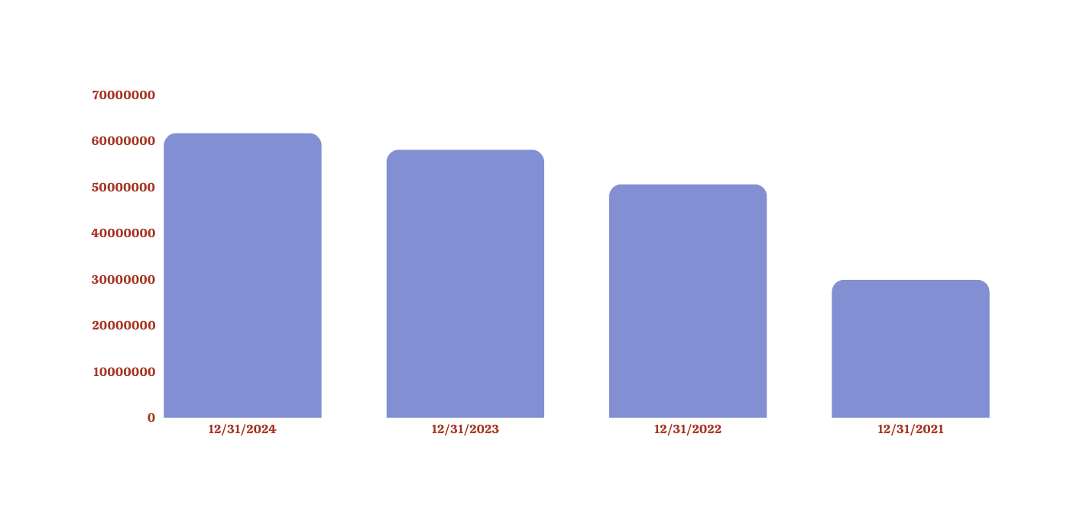
GROWTH AND PERFORMANCE
Delta Airlines has shown impressive revenue growth, increasing from $29.90 billion in 2021 to $61.64 billion in 2024, highlighting its strong recovery and expansion in the post-pandemic period.

Slide 7
As of 2025, Delta is celebrating its centenary, marking a hundred years of growth from a small crop-dusting operation to a leading global airline.
Focus on business-class and premium travel for higher revenue margins.
Delta became the first airline to commit to carbon neutrality by 2030, positioning itself as a leader in sustainability within the airline industry.

Slide 8
INDUSTRIAL COMPETITORS
United Airlines (UAL) – A key rival with an extensive global presence and strong transatlantic partnerships.
American Airlines (AAL) – The largest U.S. airline by fleet size, competing in both domestic and international markets.
Southwest Airlines (LUV) – A dominant low-cost carrier in the U.S. domestic market.
International Competitors – British Airways, Lufthansa, Emirates, Air France-KLM, and Singapore Airlines in long-haul markets.

Slide 9
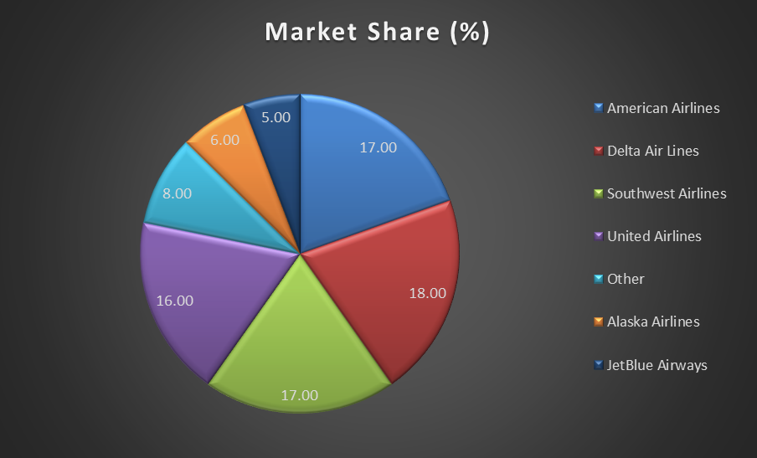
MARKET SHARE

Slide 10
RATIO ANALYSIS – LIQUIDITY RATIO
CURRENT RATIO – 0.37
QUICK RATIO – 0.32
CASH RATIO – 0.12

Slide 11
PROFITABILITY RATIOS
GROSS PROFIT MARGIN – 24.61%
OPERATING PROFIT MARGIN – 9.73%
RETURN ON ASSETS – 4.59%
RETURN ON SALES – 8.77%
RETURN ON EQUITY – 22.61%
RETURN ON INVESTMENT – 11.79%

Slide 12
SOLVENCY RATIOS
DEBT TO EQUITY – 1.49
SOLVENCY RATIO – 36.87%

Slide 13
PRICE TO EARNING RATIO – 8.13
DIVIDEND PAYOUT RATIO – 11.26%

Slide 14
CAPM
When making investment decisions, it help investors and businesses to evaluate the relationship between risk and expected return.
BETA - 1.34
GEOMEAN - 0.85%
RISK FREE RATE(Rf) - 3.13%
EXPECTED MARKET RETURN(Rm) - 10.65%
EXPECTED RETURN(Ra) - 13.21%

Slide 15
WEIGHTED AVERAGE COST OF CAPITAL
WEIGHT OF DEBT – 44.83%
WEIGHT OF EQUITY – 55.17%
COST OF EQUITY – 13.21%
AFTER TAX COST OF DEBT – 3.42%
WEIGHTED AVERAGE COST OF CAPITAL – 8.82%

Slide 16
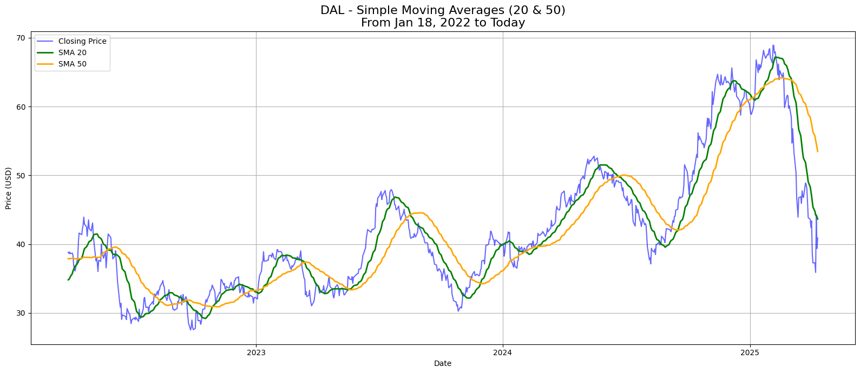
SMA 20 AND 50

Slide 17
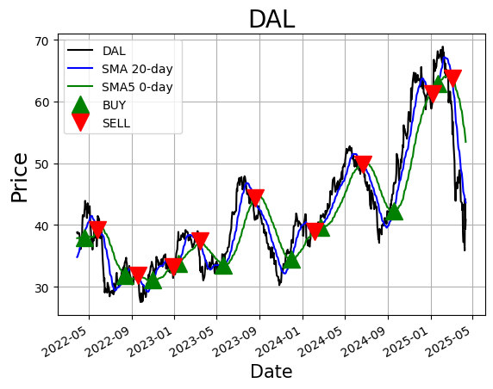
TRADING SIGNALS

Slide 18
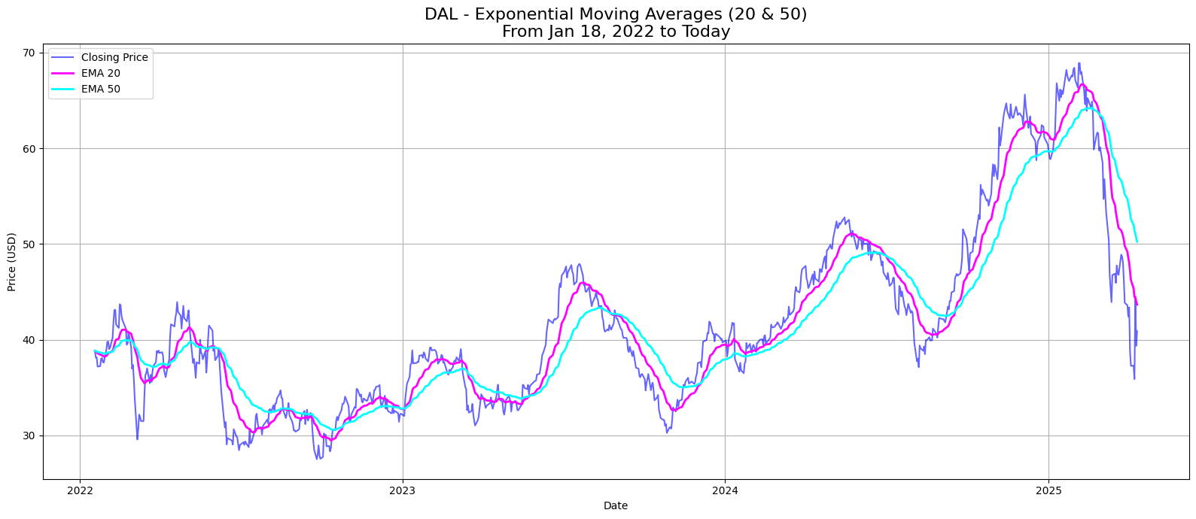
EMA 20 AND 50

Slide 19
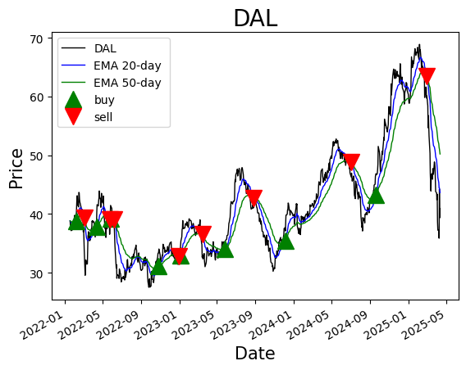
TRADING SIGNALS

Slide 20
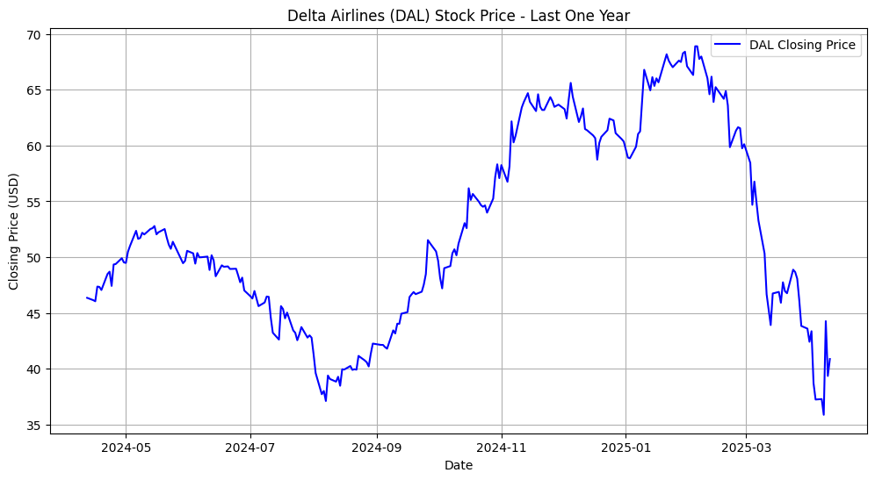
STOCK PRICE TREND ANALYSIS

Slide 21
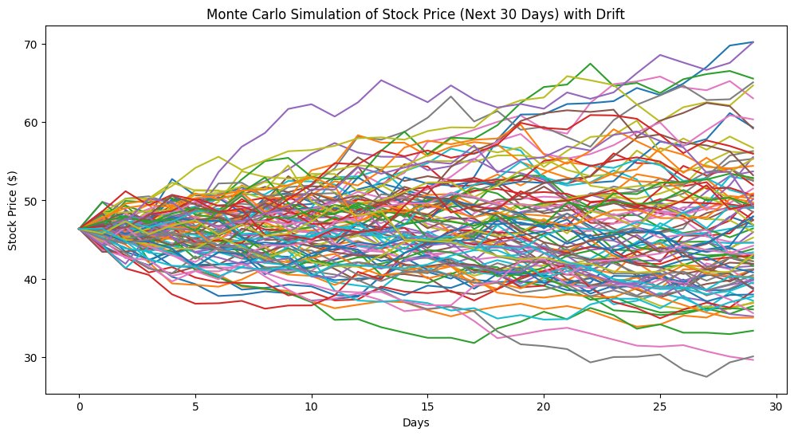
MONTE CARLO SIMULATION
The Monte Carlo simulation graph shows a wide spread of possible stock price movements over the next 30 days, indicating high uncertainty.

Slide 22
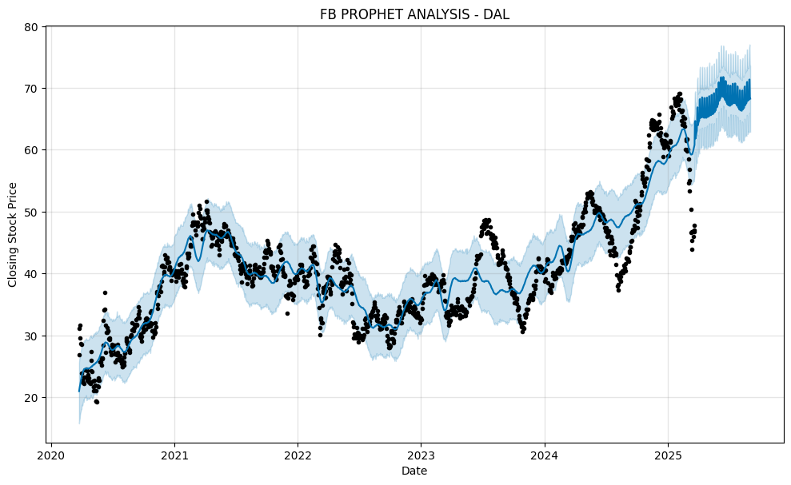
FB PROPHET ANALYSIS
The stock price of DAL has shown an upward trend from 2020 to 2025. The forecast for 2025 suggests continued growth, with the price expected to rise above $70. Despite the fluctuations, the forecast suggests strong long-term growth potential.

Slide 23
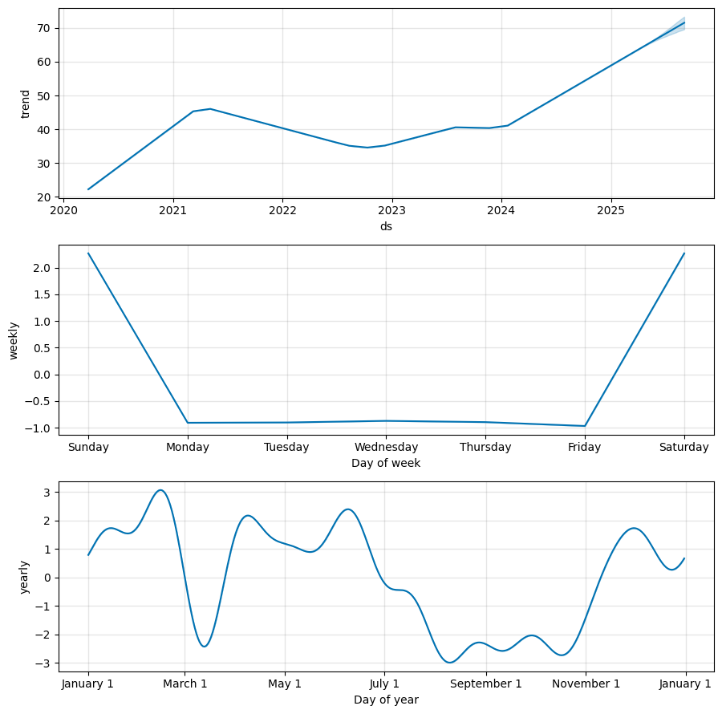
This image shows three key components of the stock price prediction using FB Prophet:
1. Trend Component (Top Graph) : This suggests the stock had a period of volatility but is now in a strong bullish trend.
2. Weekly Seasonality (Middle Graph) : Monday to Friday have almost no movement, suggesting that the price does not fluctuate significantly on weekdays.
3. Monthly Seasonality (Bottom Graph): A significant dip is observed around August-September. A recovery starts in November and continues into the new year.

Slide 24



RECOMMENDATIONS
Long-term investors are encouraged to buy and hold, especially during seasonal price dips, as the forecast suggests the stock could rise above $70 by 2025.
Current shareholders should hold, benefiting from long-term growth while riding out short-term fluctuations.
Short-term or risk-averse investors might consider selling or avoiding due to potential near-term volatility, as indicated by Monte Carlo simulations .

Slide 25
CONCLUSION
OVERALL, DAL IS A STRONG CANDIDATE FOR LONG-TERM PORTFOLIOS BUT SHOULD BE APPROACHED WITH CAUTION IN THE SHORT TERM.
THE COMPANY’S FUNDAMENTALS ARE SOUND, WITH HEALTHY LIQUIDITY AND PROFITABILITY RATIOS
DELTA IS A STRONG GLOBAL AIRLINE WITH ROBUST FINANCIAL RECOVERY.

Slide 26
REFERENCES
https://www.statista.com/statistics/250577/domestic-market-share-of-leading-us-airlines/
https://news.delta.com/deltas-history-dusting-crops-connecting-world
https://ca.finance.yahoo.com/news/delta-air-lines-dal-among-201831568.html
https://www.aerotime.aero/articles/delta-airlines-centenary-2025-airline-history
https://www.visualcapitalist.com/ranked-the-largest-airlines-in-the-u-s-by-market-share/
https://www.boerse-frankfurt.de/bond/usu24740am10-delta-air-lines-inc-7-20-25

Slide 27


